Slide 1
Wrapper Scenario

Slide 2
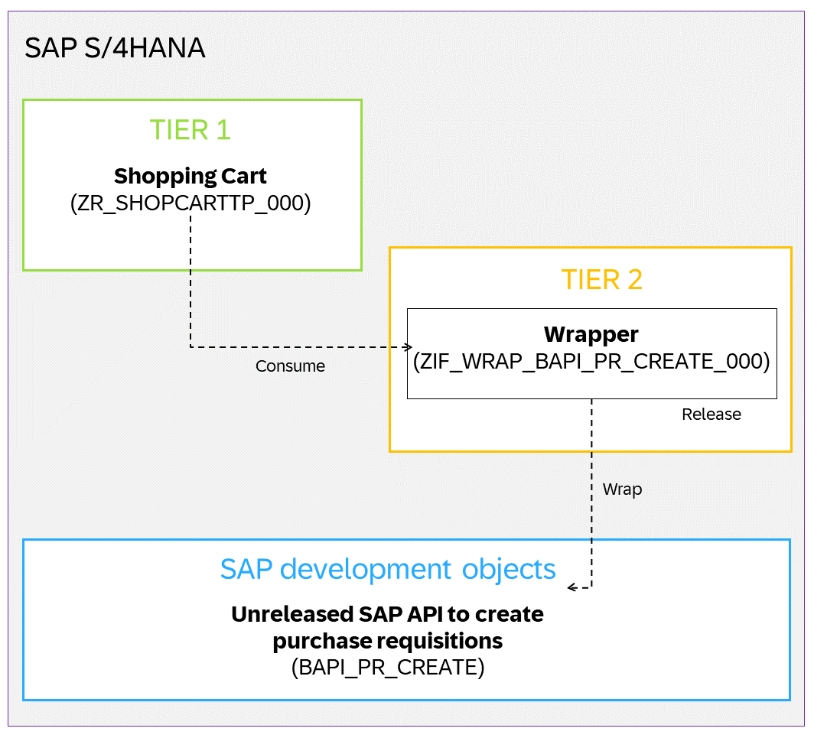
Wrapper Scenario
How to wrap the BAPI_PR_CREATE in your SAP S/4HANA system and release it for consumption in tier 1.

Slide 3
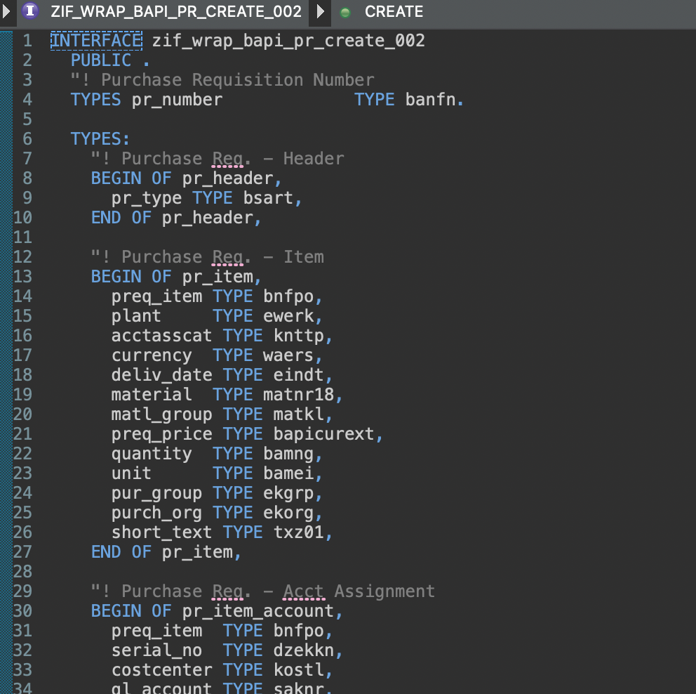
Create Interface (local)

Slide 4
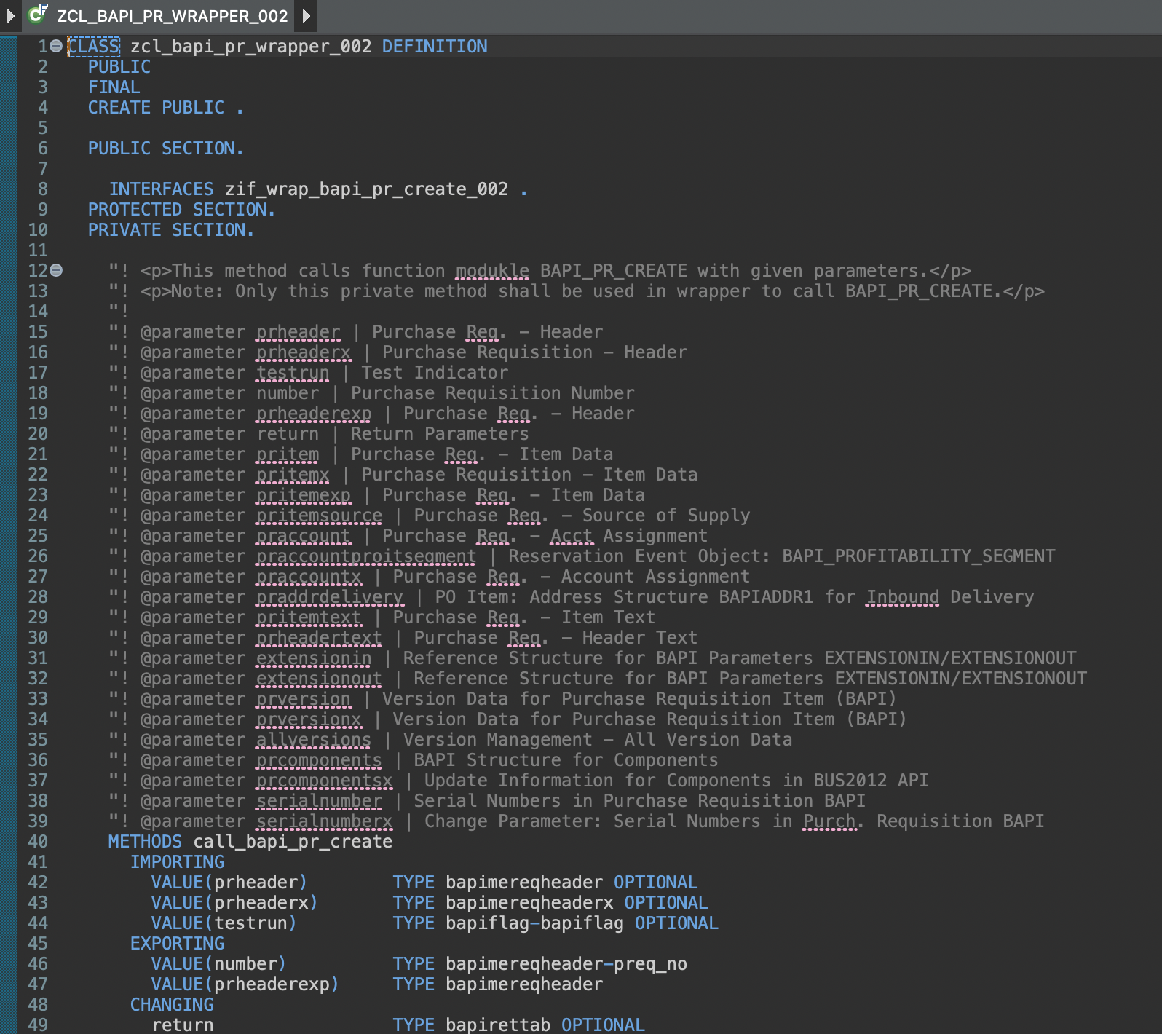
Create Wrapper class

Slide 5
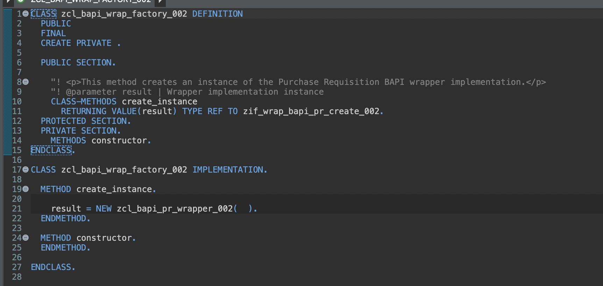
Create Wrapper factory class

Slide 6
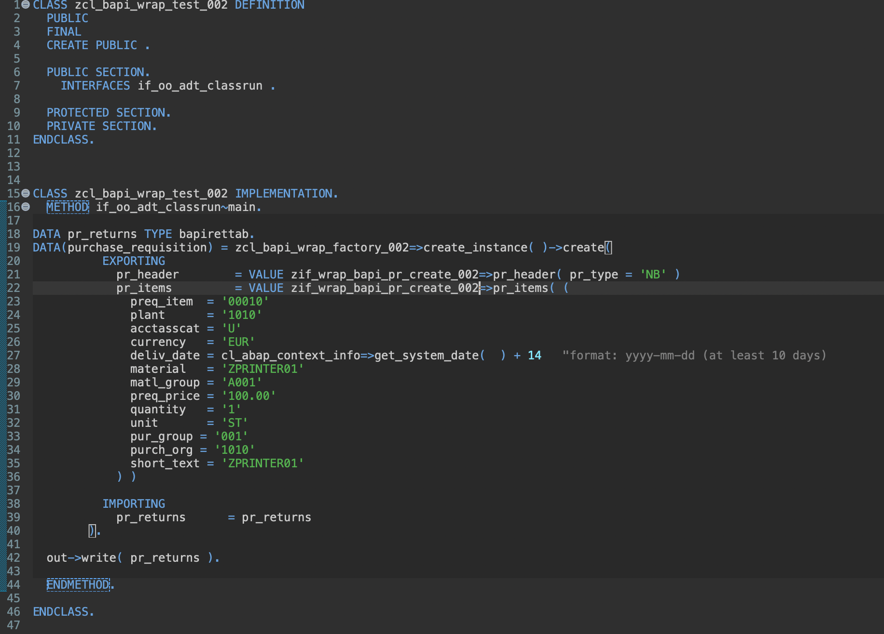
Implement Test Class

Slide 7
Together
Set Release State and option “Use in Cloud Development“.

Slide 8
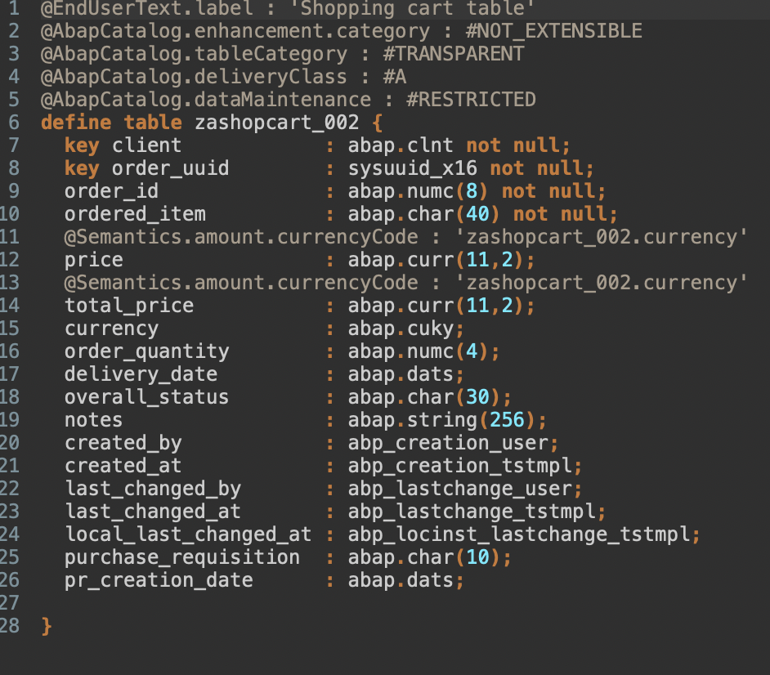
Create DB Table

Slide 9
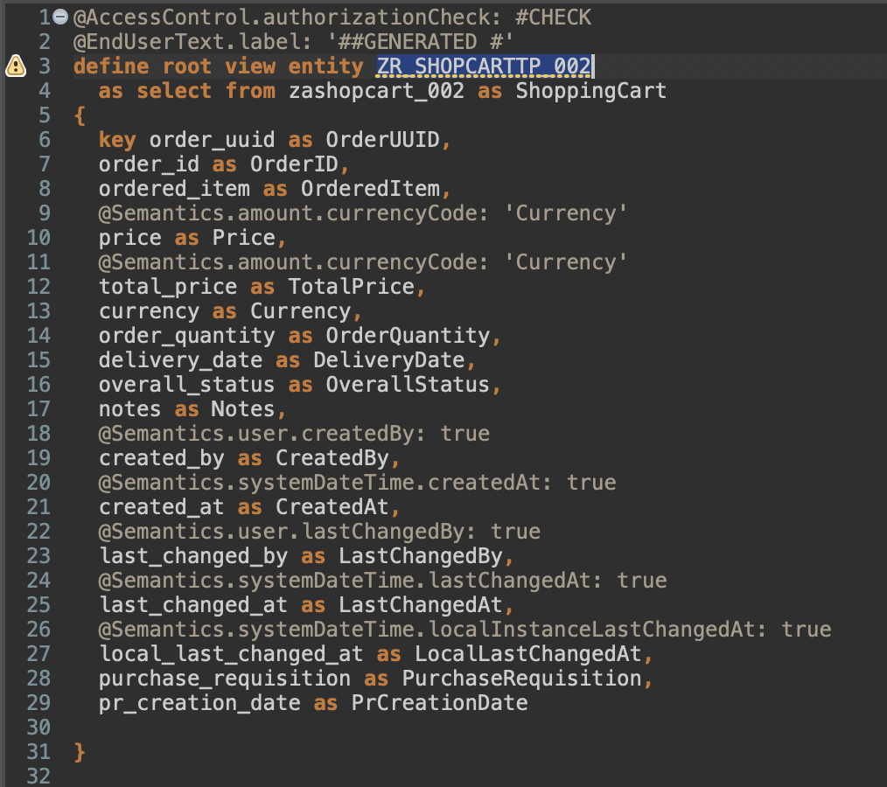
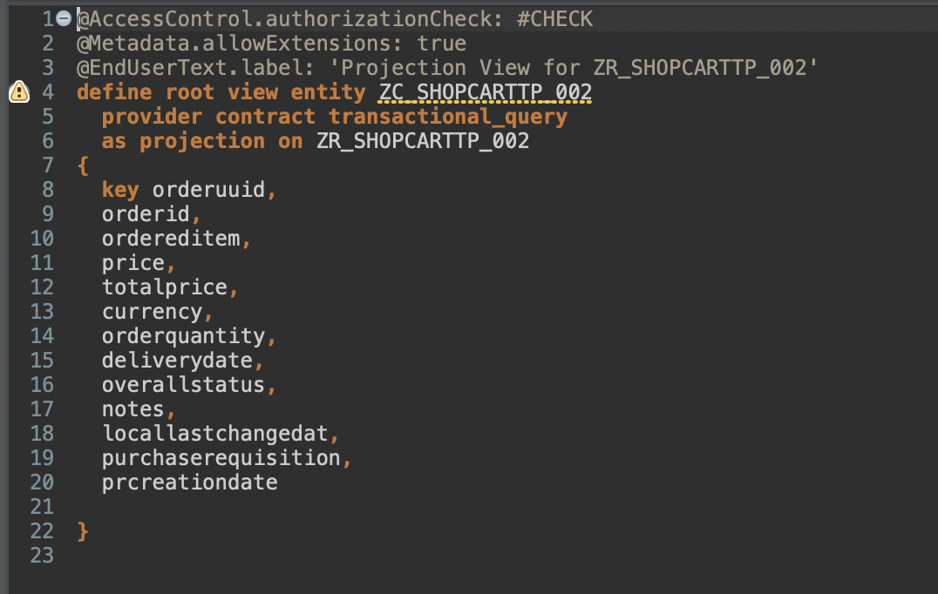
Create Views

Slide 10
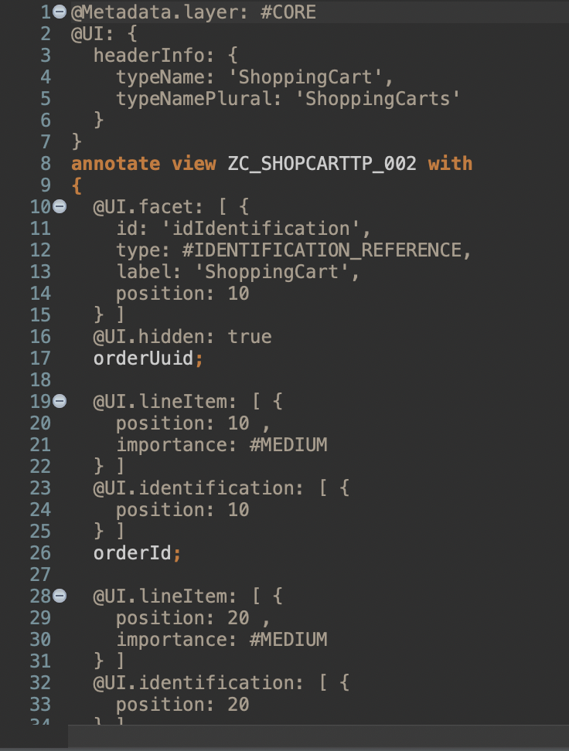
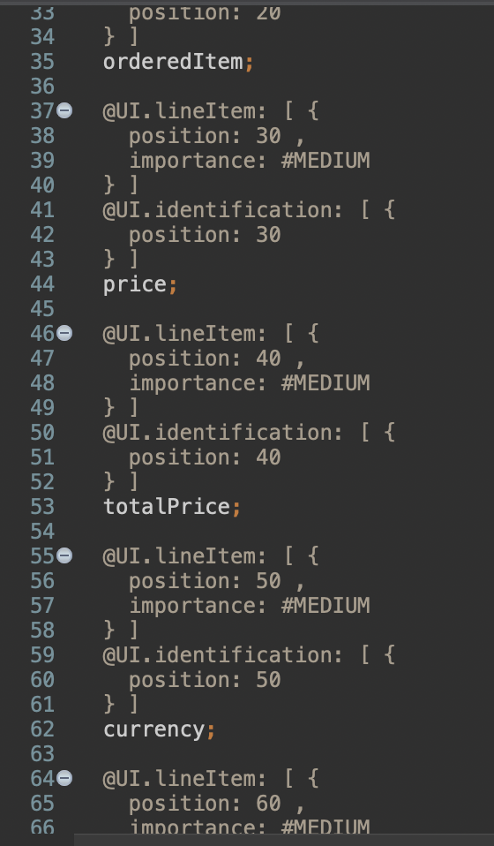
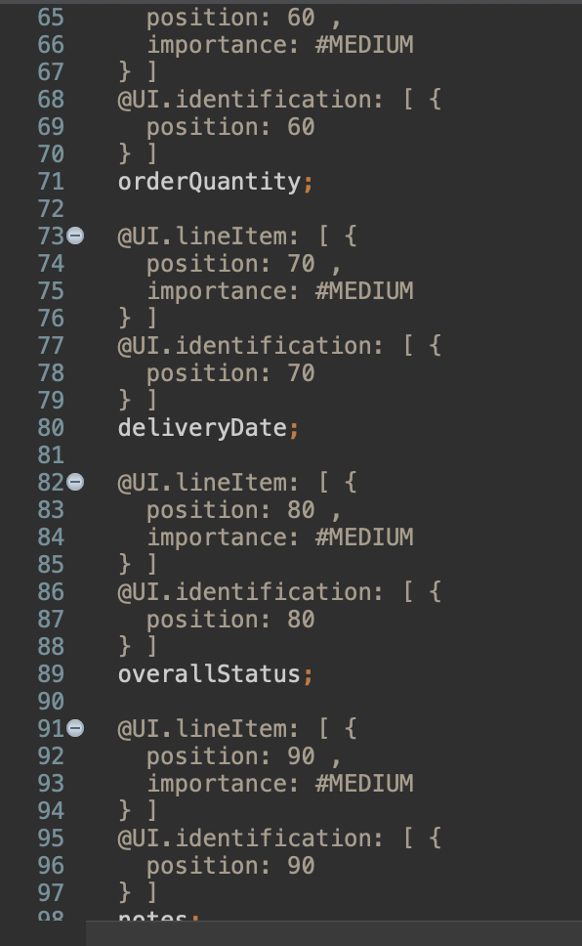
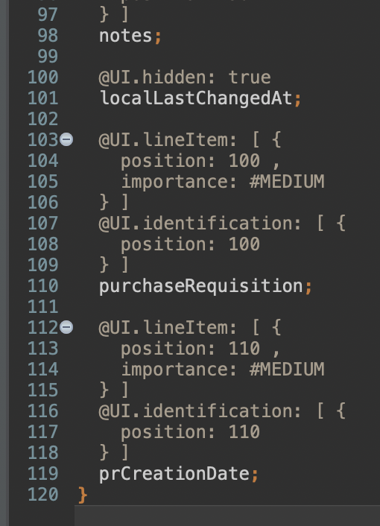
Create Metadata Extension

Slide 11
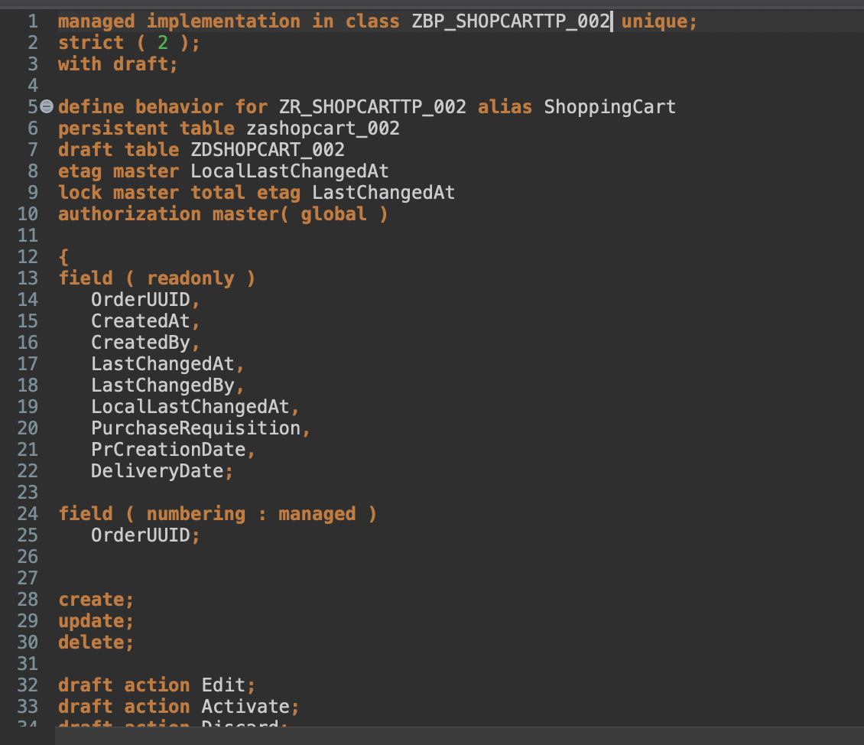
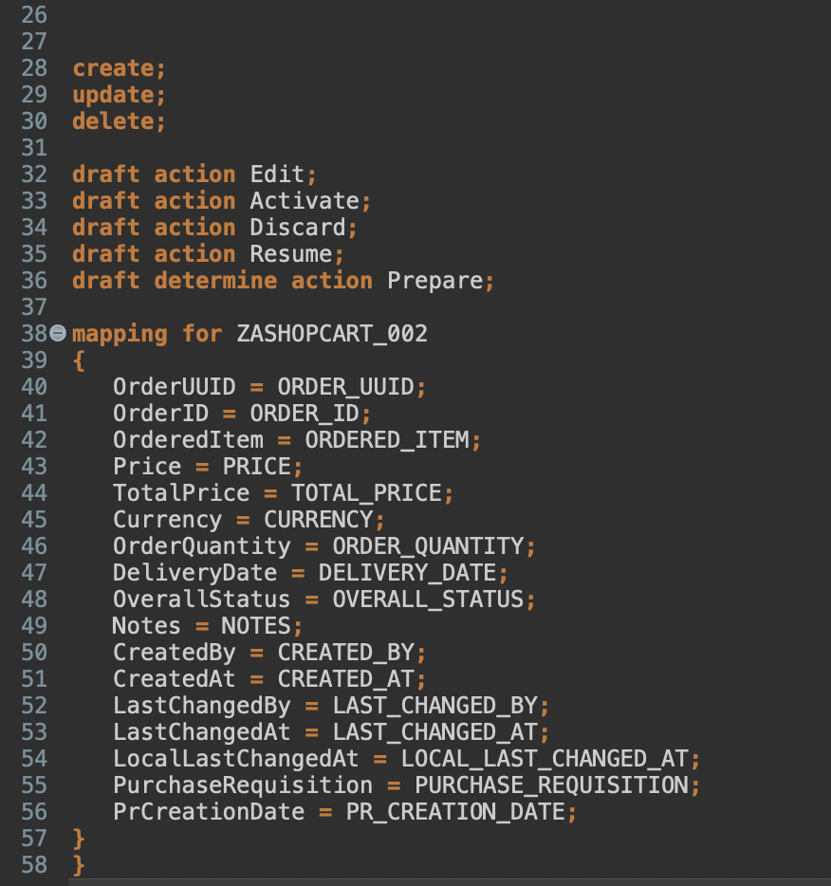
Enhance Behavior Definition

Slide 12
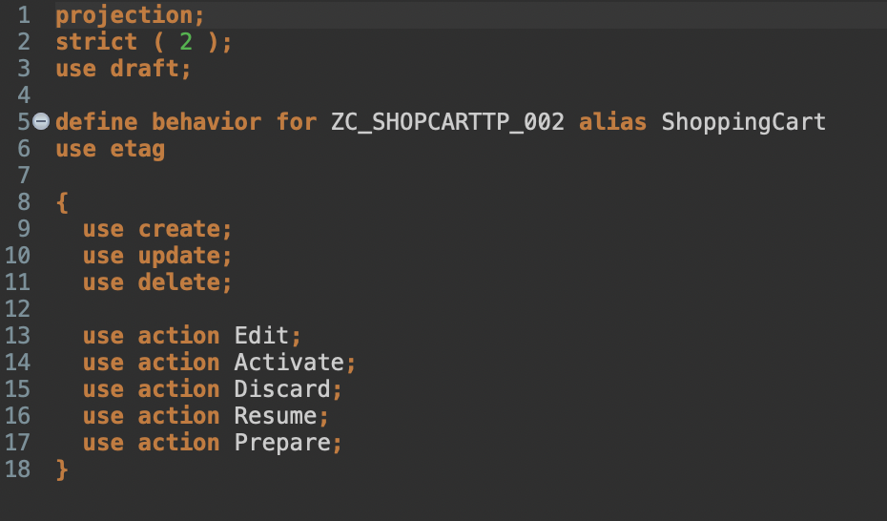
Create Behavior Projection

Slide 13
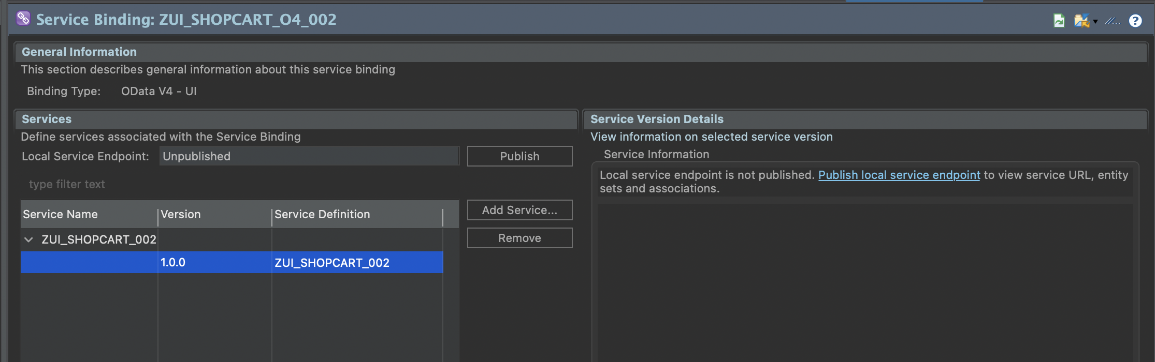
Publish service binding and run SAP Fiori Elements preview
/IWFND/V4_ADMIN

Slide 14
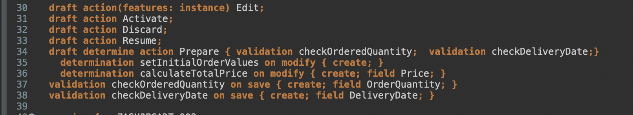
Enhance behavior definition of data model

Slide 15
Create data definition for products
Create a Value Help ZI_PRODUCTS_### for Product as select from I_Product.
Fields
Product
Price
Currency
ProductGroup
BaseUnit

Slide 16
Enhance Metadata
@Consumption.valueHelpDefinition: [{ entity: {name: 'ZI_PRODUCTS_###' , element: 'ProductText' }, additionalBinding: [{ localElement: 'price', element: 'Price', usage: #RESULT }, { localElement: 'currency', element: 'Currency', usage: #RESULT } ] }]
Annotation for field ordereditem;

Slide 17
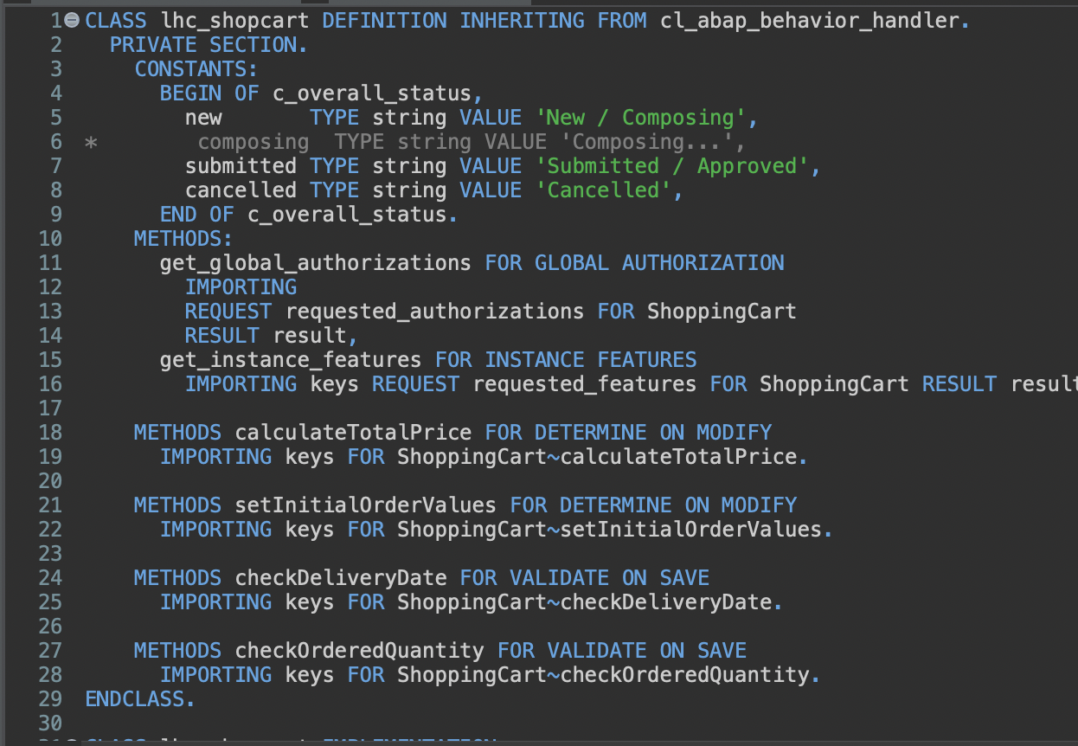
Enhance behavior implementation

Slide 18
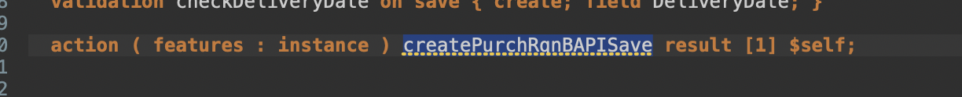
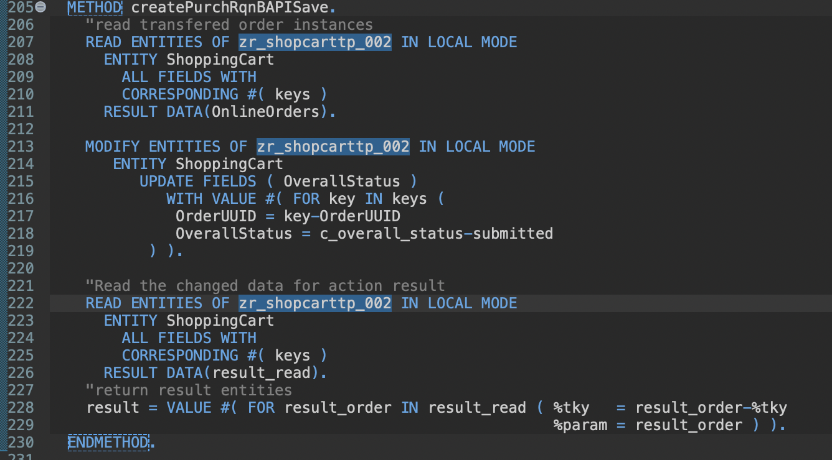
Implement new action createPurchRqnBAPISave

Slide 19
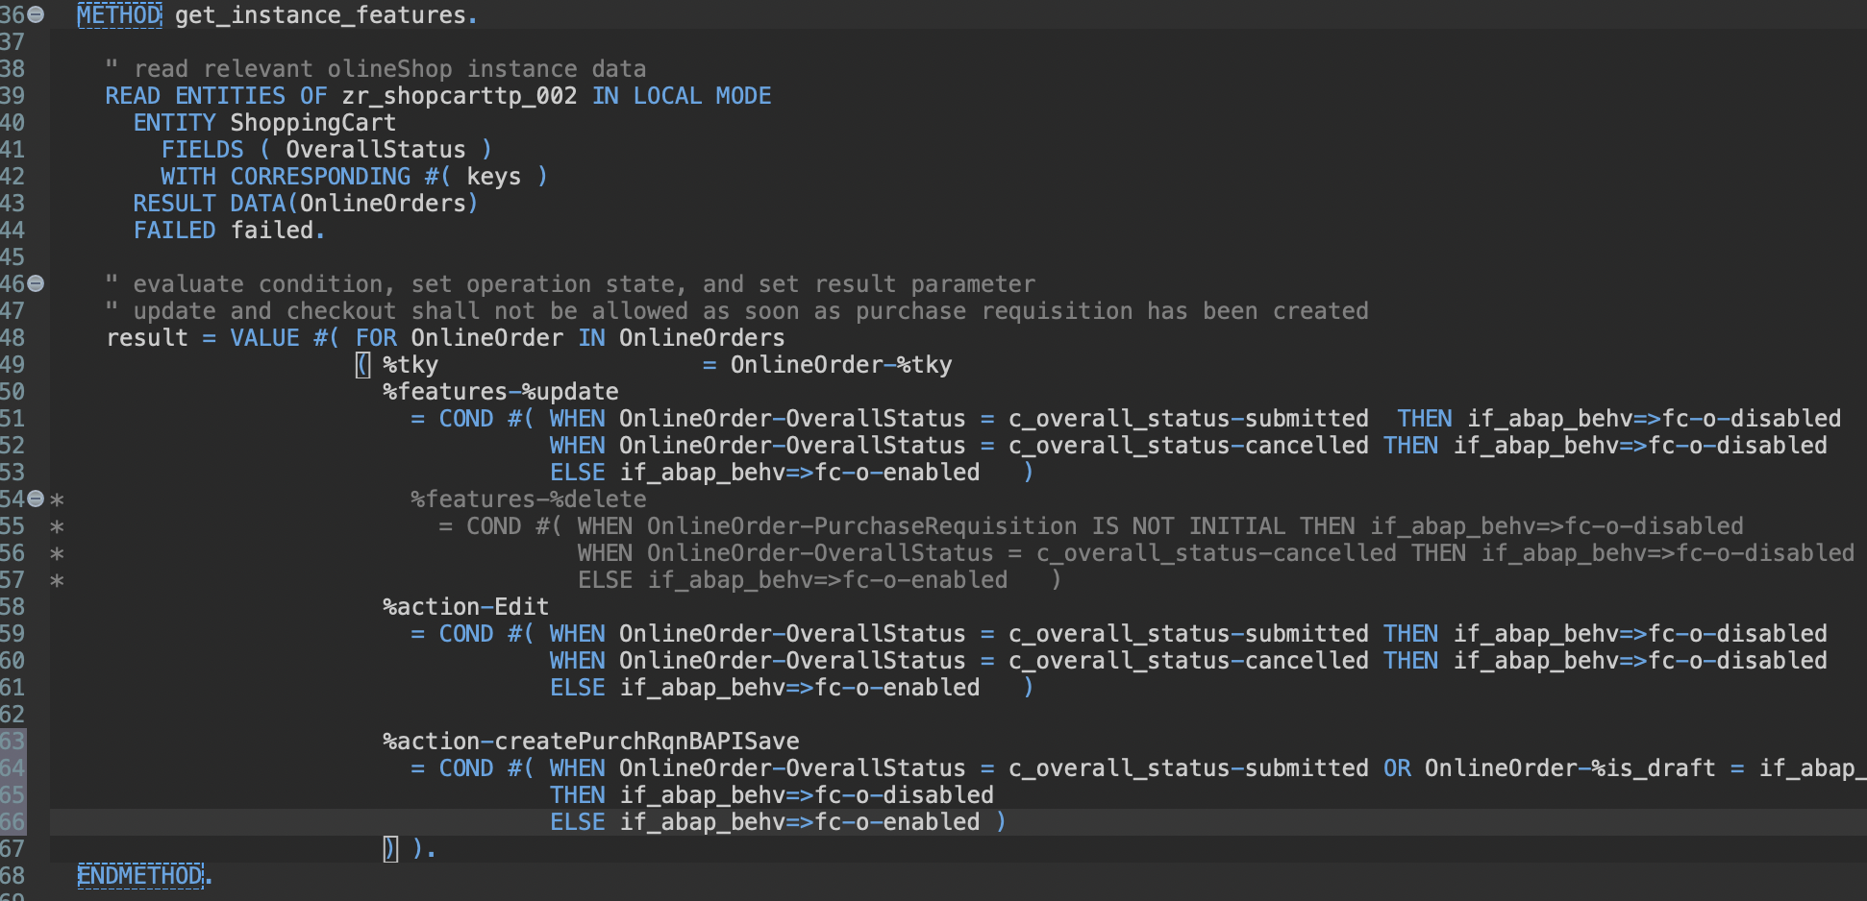
Implement new action createPurchRqnBAPISave
Change get_instance_features wit createPurchRqnBAPISave

Slide 20
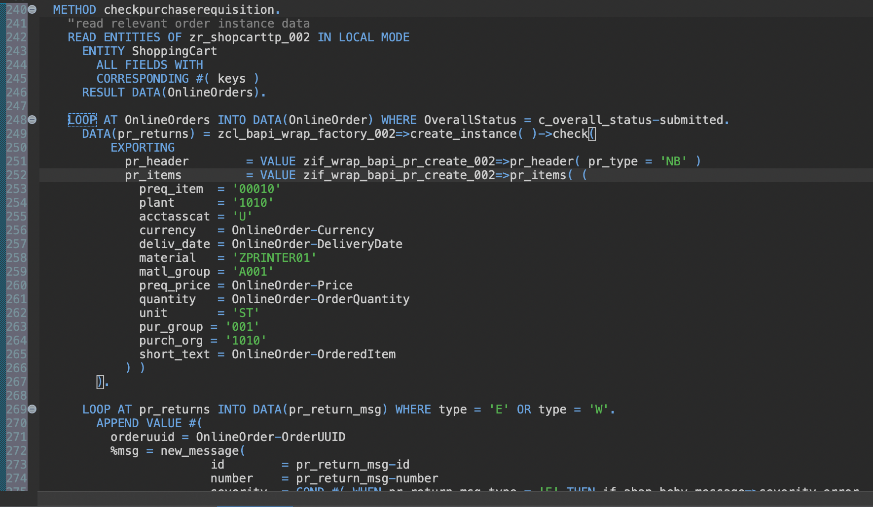
Implement on save validation using the BAPI test mode

Slide 21
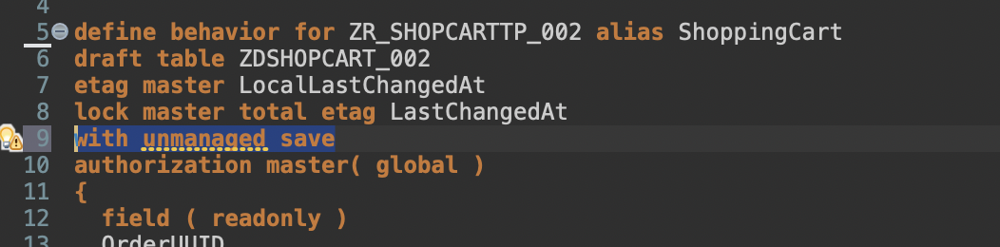
Implement unmanaged save
Add with unmanaged save
Delete persistent table zashopcart_002

Slide 22
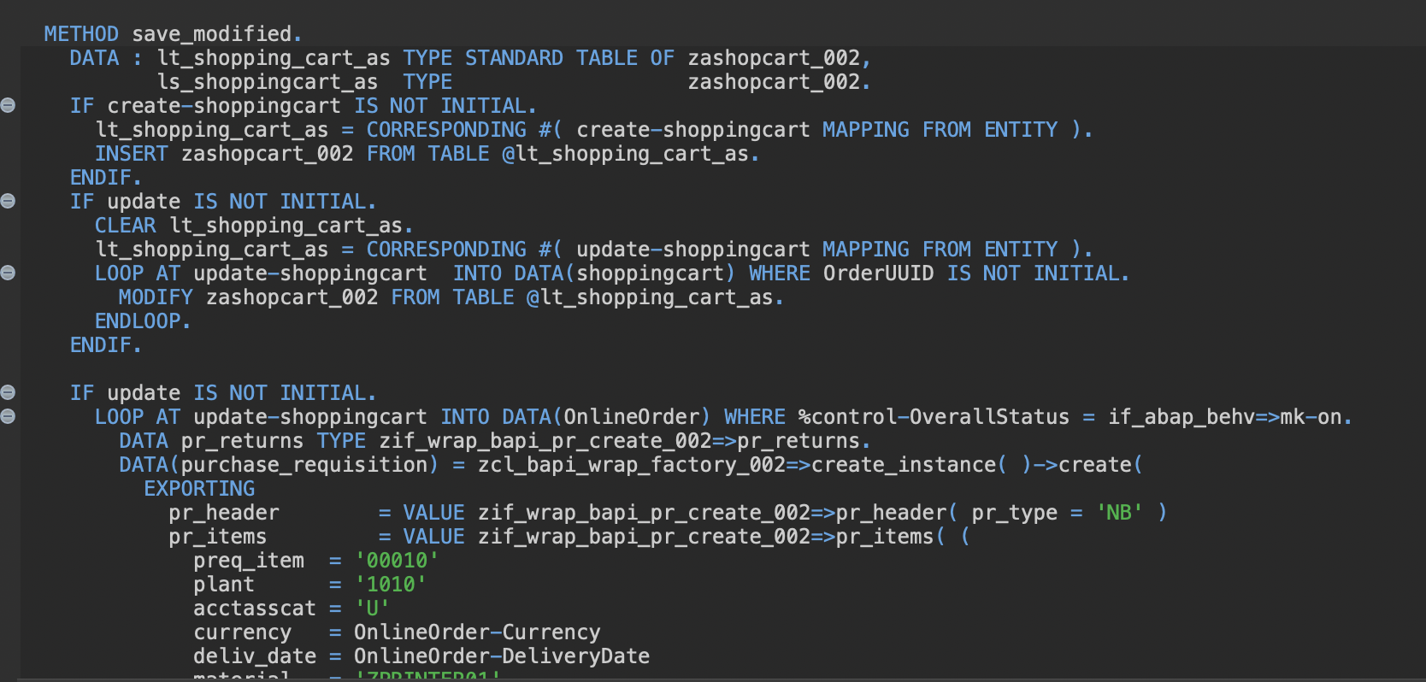
Implement unmanaged save

Slide 23
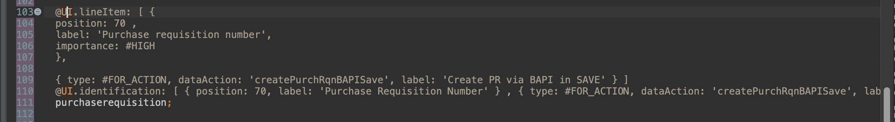
Expose the new action in Metadata Extension

Slide 24
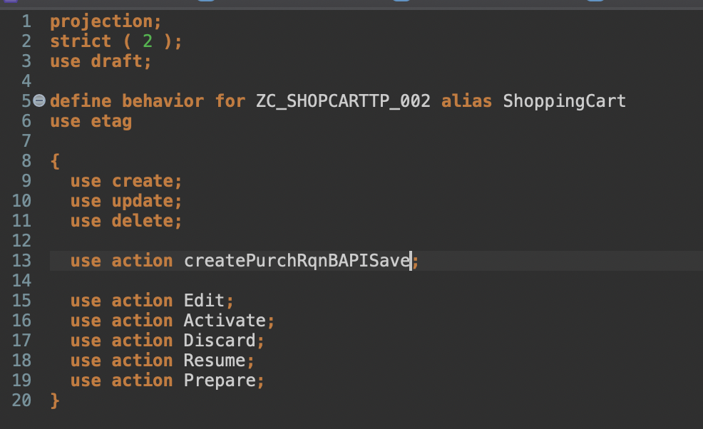
Expose the new action

Slide 25
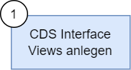
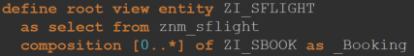
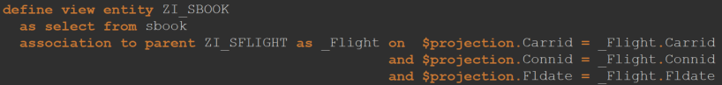
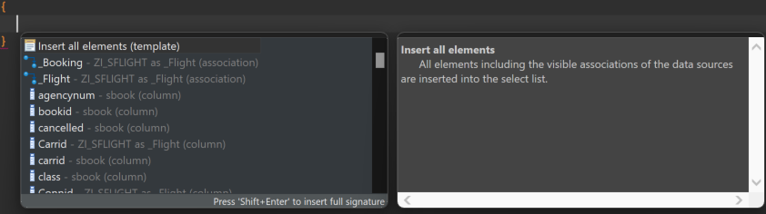
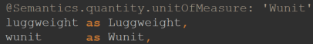
Wurzelentität und Kind Entitäten definieren
Datenquelle angeben
Elemente der Entitäten einfügen
Beziehungen zwischen Wurzel- und Kind Entitäten definieren
Semantische Eigenschaften der Elemente annotieren

Slide 26
@AbapCatalog.viewEnhancementCategory: [#NONE]
@AccessControl.authorizationCheck: #NOT_REQUIRED
@EndUserText.label: 'Interface View SBook'
@Metadata.ignorePropagatedAnnotations: true
@ObjectModel.usageType:{
serviceQuality: #X,
sizeCategory: #S,
dataClass: #MIXED
}
define view entity ZI_SBOOK
as select from sbook
association to parent ZI_SFLIGHT as _Flight on $projection.Carrid = _Flight.Carrid
and $projection.Connid = _Flight.Connid
and $projection.Fldate = _Flight.Fldate
{
key carrid as Carrid,
key connid as Connid,
key fldate as Fldate,
key bookid as Bookid,
customid as Customid,
custtype as Custtype,
smoker as Smoker,
@Semantics.quantity.unitOfMeasure: 'Wunit'
luggweight as Luggweight,
wunit as Wunit,
invoice as Invoice,
class as Class,
@Semantics.amount.currencyCode: 'Forcurkey'
forcuram as Forcuram,
forcurkey as Forcurkey,
@Semantics.amount.currencyCode: 'Loccurkey'
loccuram as Loccuram,
loccurkey as Loccurkey,
order_date as OrderDate,
counter as Counter,
agencynum as Agencynum,
cancelled as Cancelled,
reserved as Reserved,
passname as Passname,
passform as Passform,
passbirth as Passbirth,
_Flight
}
ZI_SFLIGHT
ZI_SBOOK
@AccessControl.authorizationCheck: #NOT_REQUIRED
@EndUserText.label: 'Interface View SFlight'
define root view entity ZI_SFLIGHT
as select from znm_sflight
composition [0..*] of ZI_SBOOK as _Booking
{
key znm_sflight.carrid as Carrid,
key znm_sflight.connid as Connid,
key znm_sflight.fldate as Fldate,
znm_sflight.price as Price,
znm_sflight.currency as Currency,
znm_sflight.planetype as Planetype,
znm_sflight.seatsmax as Seatsmax,
znm_sflight.seatsocc as Seatsocc,
znm_sflight.paymentsum as Paymentsum,
znm_sflight.seatsmax_b as SeatsmaxB,
znm_sflight.seatsocc_b as SeatsoccB,
znm_sflight.seatsmax_f as SeatsmaxF,
znm_sflight.seatsocc_f as SeatsoccF,
znm_sflight.created_at as CreatedAt,
znm_sflight.created_by as CreatedBy,
znm_sflight.last_changed_at as LastChangedAt,
znm_sflight.last_changed_by as LastChangedBy,
znm_sflight.locl_last_changed_at as LocalLastChangedAt,
_Booking
}

Slide 27
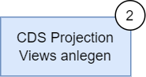
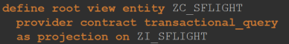
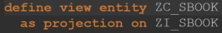
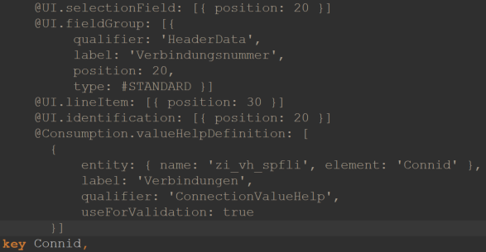
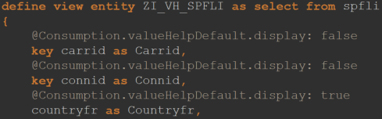
Projection Views anlegen
UI Annotation hinzufügen
lineItem: Anzeige des Elements in Liste
selectionField: Anlegen eines Selektionsfelds des Elements
Identification: Markierung des Elements für Referenz auf Object Page
fieldGroup: Zuweisungd es Elements zu einer Elementgruppe auf der Object Page
Value Help CDS View anlegen und in valueHelpDefinition annotation referenzieren

Slide 28
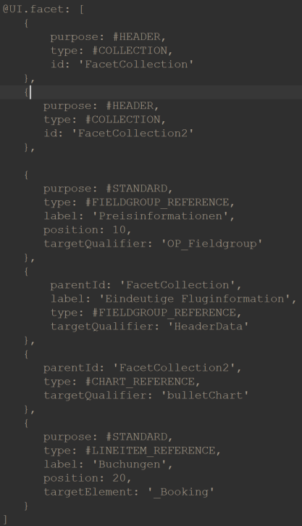
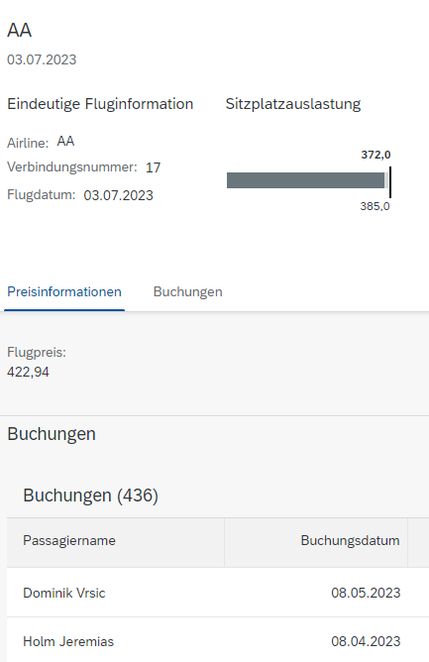
Zu Beginn der Definition werden Facetten für die Object Page definiert
purpose: definiert Zuordnung der Facette zum Header oder zum Standardbereich
type: definiert den Typen der Facette
Verschiedene Facettentypen benötigen unterschiedliche Handhabenung
Beziehungen müssen als Element in die Elementliste aufgenommen werden

Slide 29
ZC_SFLIGHT
@Consumption.valueHelpDefinition: [
{
entity: { name: 'zi_vh_scarr', element: 'Carrid' },
label: 'Fluggesellschaften',
qualifier: 'CarrierValueHelp',
useForValidation: true
}]
@UI: {
lineItem: [
{
position: 10,
importance: #HIGH
}
],
selectionField: [{ position: 10 }],
fieldGroup: [
{
qualifier: 'HeaderData',
position: 10,
label: 'Airline'
}
],
multiLineText: true
}
@UI.identification: [{ position: 10 }]
key Carrid,
@UI.selectionField: [{ position: 20 }]
@UI.fieldGroup: [{
qualifier: 'HeaderData',
label: 'Verbindungsnummer',
position: 20,
type: #STANDARD }]
@UI.lineItem: [{ position: 30 }]
@UI.identification: [{ position: 20 }]
@Consumption.valueHelpDefinition: [
{
entity: { name: 'zi_vh_spfli', element: 'Connid' },
label: 'Verbindungen',
qualifier: 'ConnectionValueHelp',
useForValidation: true
}]
key Connid,
@UI.facet: [
{
purpose: #HEADER,
type: #COLLECTION,
id: 'FacetCollection'
},
{
purpose: #HEADER,
type: #COLLECTION,
id: 'FacetCollection2'
},
{
purpose: #STANDARD,
type: #FIELDGROUP_REFERENCE,
label: 'Preisinformationen',
position: 10,
targetQualifier: 'OP_Fieldgroup'
},
{
parentId: 'FacetCollection',
label: 'Eindeutige Fluginformation',
type: #FIELDGROUP_REFERENCE,
targetQualifier: 'HeaderData'
},
{
parentId: 'FacetCollection2',
type: #CHART_REFERENCE,
targetQualifier: 'bulletChart'
},
{
purpose: #STANDARD,
type: #LINEITEM_REFERENCE,
label: 'Buchungen',
position: 20,
targetElement: '_Booking'
}
]
@EndUserText.label: 'Projection View SFLIGHT'
@AccessControl.authorizationCheck: #NOT_REQUIRED
@UI.headerInfo: {
typeName: 'Flug Root',
typeNamePlural: 'Flüge Root',
title: {
value: 'Carrid',
type: #STANDARD,
label: 'Test'
},
description: {
label: 'Flug Root',
type: #STANDARD,
value: 'Fldate'
}
}
@UI.chart: [
{
qualifier: 'bulletChart',
title: 'Sitzplatzauslastung',
chartType: #BULLET,
measures: [ 'Seatsocc' ],
measureAttributes: [{
measure: 'Seatsocc',
role: #AXIS_1,
asDataPoint: true
}]
}
]
define root view entity ZC_SFLIGHT
provider contract transactional_query
as projection on ZI_SFLIGHT
{

Slide 30
ZC_SFLIGHT
@UI.selectionField: [{ position: 30 }]
@UI.lineItem: [{ position: 40 }]
@UI.fieldGroup: [{
qualifier: 'HeaderData',
label: 'Flugdatum',
position: 30,
type: #STANDARD }]
@UI.identification: [{ position: 30 }]
key Fldate,
@UI.fieldGroup: [{
qualifier: 'OP_Fieldgroup',
position: 10
}]
@UI.identification: [{ position: 40 }]
Price,
Currency,
@UI.lineItem: [{ position: 80 }]
@UI.identification: [{ position: 50 }]
Planetype,
Seatsmax,
@UI: {
dataPoint: {
qualifier: 'Seatsocc',
targetValueElement: 'Seatsmax',
visualization: #PROGRESS,
title: 'Auslastung'
},
lineItem: [
{
type: #AS_DATAPOINT,
label: 'Sitzplatzauslastung Economy',
importance: #HIGH,
position: 50,
valueQualifier: 'Seatsocc'
}
]
}
Seatsocc,
@UI.lineItem: [{ position: 100 }]
Paymentsum,
@Consumption.filter.hidden: true
SeatsmaxB,
@Consumption.filter.hidden: true
@UI.lineItem: [{ position: 100 }]
SeatsoccB,
@Consumption.filter.hidden: true
SeatsmaxF,
@Consumption.filter.hidden: true
@UI.lineItem: [{ position: 100 }]
SeatsoccF,
CreatedAt,
CreatedBy,
LastChangedAt,
LastChangedBy,
LocalLastChangedAt,
/* Associations */
_Booking : redirected to composition child ZC_SBOOK
}

Slide 31
ZC_SBOOK
key Carrid,
key Connid,
key Fldate,
@UI.lineItem: [{ position: 50 }]
@UI.identification: [{ position: 10 }]
key Bookid,
@UI.identification: [{ position: 20 }]
Customid,
@UI.identification: [{ position: 30 }]
Custtype,
@UI.identification: [{ position: 40 }]
Smoker,
@UI.lineItem: [{ position: 30 }]
@UI.identification: [{ position: 50,
type: #FOR_ACTION,
dataAction: 'upgrade_class',
label: 'Upgrade' }]
Luggweight,
Wunit,
Invoice,
@UI.lineItem: [{ position: 40 }]
@UI.identification: [{ position: 51 }]
Class,
Forcuram,
Forcurkey,
Loccuram,
Loccurkey,
@UI.lineItem: [{ position: 20 }]
@UI.identification: [{ position: 60 }]
OrderDate,
Counter,
Agencynum,
Cancelled,
@UI.identification: [{ position: 70 }]
Reserved,
@UI.lineItem: [{ position: 10 }]
Passname,
Passform,
Passbirth,
/* Associations */
_Flight: redirected to parent ZC_SFLIGHT
}
@EndUserText.label: 'Projection View SBOOK'
@AccessControl.authorizationCheck: #NOT_REQUIRED
@UI.headerInfo: {
typeName: 'Buchung',
typeNamePlural: 'Buchungen',
title: {
value: 'Passname',
type: #STANDARD,
label: 'Name'
},
description: {
label: 'Buchungsnummer',
type: #STANDARD,
value: 'Bookid'
}
}
define view entity ZC_SBOOK
as projection on ZI_SBOOK
{
@UI.facet: [{ purpose: #STANDARD,
position: 10,
label: 'Buchungsinformationen',
type: #IDENTIFICATION_REFERENCE }]

Slide 32
ZI_VH_SCARR
ZI_VH_SPFLI
@AbapCatalog.viewEnhancementCategory: [#NONE]
@AccessControl.authorizationCheck: #NOT_REQUIRED
@EndUserText.label: 'Value Help Carrier'
@Metadata.ignorePropagatedAnnotations: true
@ObjectModel.usageType:{
serviceQuality: #X,
sizeCategory: #S,
dataClass: #MIXED
}
define view entity ZI_VH_SCARR as select from scarr
{
@Consumption.valueHelpDefault.display: false
key carrid as Carrid,
@Consumption.valueHelpDefault.display: true
carrname as Carrname,
@Consumption.valueHelpDefault.display: true
currcode as Currcode,
@Consumption.valueHelpDefault.display: true
url as Url
}
@AbapCatalog.viewEnhancementCategory: [#NONE]
@AccessControl.authorizationCheck: #NOT_REQUIRED
@EndUserText.label: 'Value Help Connection'
@Metadata.ignorePropagatedAnnotations: true
@ObjectModel.usageType:{
serviceQuality: #X,
sizeCategory: #S,
dataClass: #MIXED
}
define view entity ZI_VH_SPFLI as select from spfli
{
@Consumption.valueHelpDefault.display: false
key carrid as Carrid,
@Consumption.valueHelpDefault.display: false
key connid as Connid,
@Consumption.valueHelpDefault.display: true
countryfr as Countryfr,
@Consumption.valueHelpDefault.display: true
cityfrom as Cityfrom,
@Consumption.valueHelpDefault.display: true
countryto as Countryto,
@Consumption.valueHelpDefault.display: true
cityto as Cityto
}

Slide 33
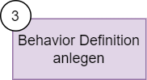
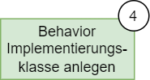
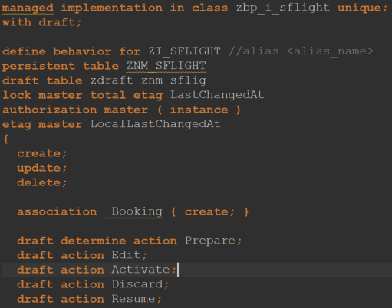
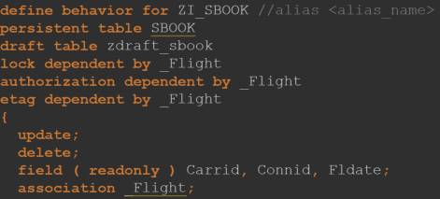
Behavior Definition für Wurzel Entität und Kind Entitäten in einem Entwicklungsobjekt anlegen
Namen für Implementierungsklasse angeben und über die Hilfe automatisch anlegen lassen
Namen für die persistente und draft Tabellen können angegeben und mit der Hilfe automatisch angelegt werden
Sperr- und Authorisierungsverhalten definieren
CRUD Operationen angeben, die für die Geschäftsobjekte möglich sein sollen
Bei der Verwendung von Draft sind die Actions Prepare, Edit, Activate, Discard und Resume verpflichtend anzugeben

Slide 34
ZI_SFLIGHT
managed implementation in class zbp_i_sflight unique;
with draft;
define behavior for ZI_SFLIGHT //alias <alias_name>
persistent table ZNM_SFLIGHT
draft table zdraft_znm_sflig
lock master total etag LastChangedAt
authorization master ( instance )
etag master LocalLastChangedAt
{
create;
update;
delete;
association _Booking { create; }
draft determine action Prepare;
draft action Edit;
draft action Activate;
draft action Discard;
draft action Resume;
validation validateFlightDate on save {create;}
}
define behavior for ZI_SBOOK //alias <alias_name>
persistent table SBOOK
draft table zdraft_sbook
lock dependent by _Flight
authorization dependent by _Flight
etag dependent by _Flight
{
update;
delete;
field ( readonly ) Carrid, Connid, Fldate;
association _Flight;
action ( features : instance ) upgrade_class result [1] $self;
determination checkSeatsOcc on modify {create;}
}

Slide 35
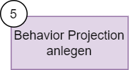
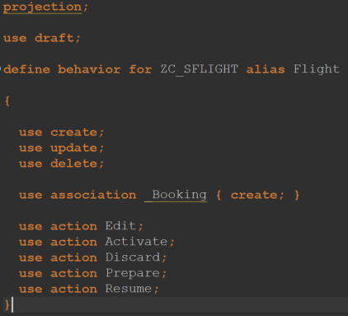
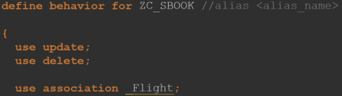
Projektionen der Behavior Definitions anlegen
CRUD Operationen angeben
Zuvor definierte Actions angeben

Slide 36
ZC_SFLIGHT
projection;
use draft;
define behavior for ZC_SFLIGHT alias Flight
{
use create;
use update;
use delete;
use association _Booking { create; }
use action Edit;
use action Activate;
use action Discard;
use action Prepare;
use action Resume;
}
define behavior for ZC_SBOOK //alias <alias_name>
{
use update;
use delete;
use association _Flight;
use action upgrade_class;
}

Slide 37
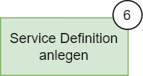
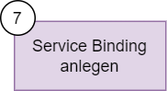
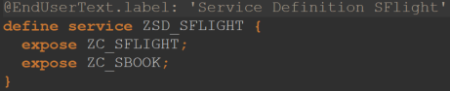
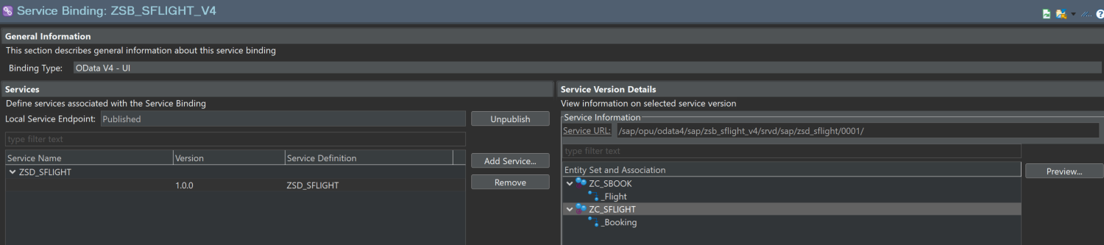
Service Definition und Binding (ODATA V4) anlegen
In Transaktion /n/iwfnd/v4_admin Service veröffentlichen
In Service Binding auf ZC_SFLIGHT und dann auf Preview klicken

Slide 38
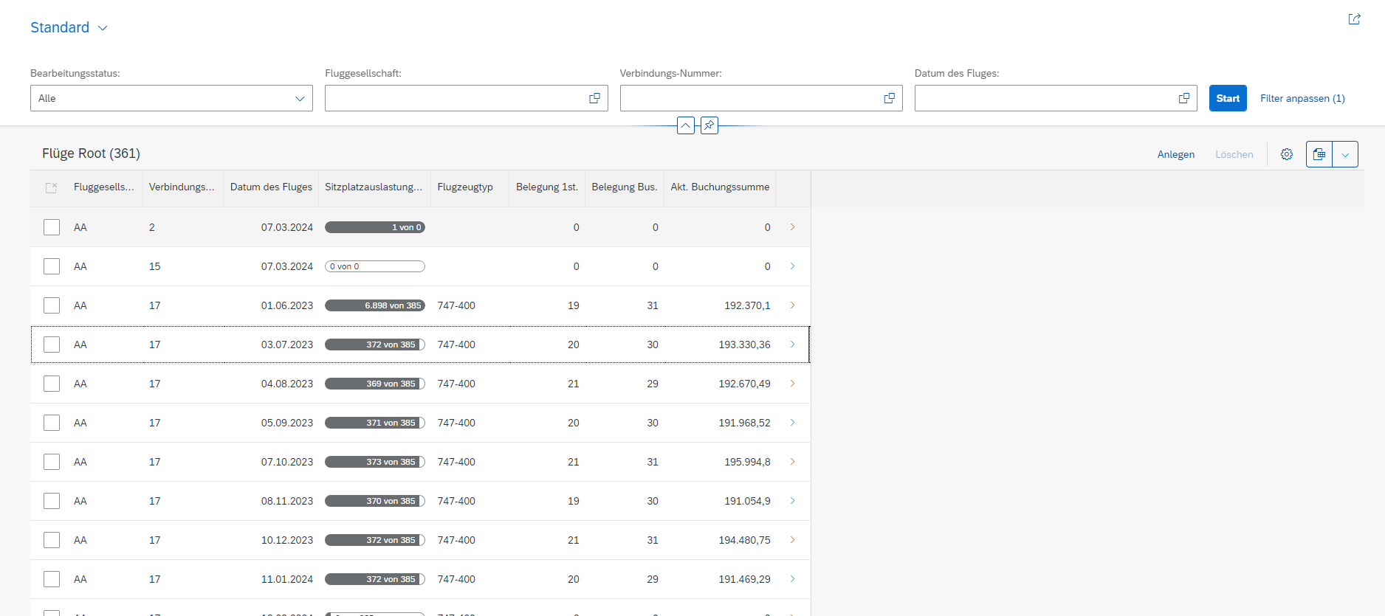

Slide 39


Slide 40
Transaktionales Verhalten

Slide 41


CRUD Operationen
Die Standardoperationen Create, Read, Update, Delete werden im RAP Managed Scenario vom BO-Provider zur Verfügung gestellt und müssen nicht manuell implementiert werden
Die entsprechenden Buttons erscheinen in der UI, sobald die entsprechenden Definitionen in den Behavior Definitions vorgenommen wurden

Slide 42


Actions
Die Action in Behavior Definition angeben
Die Action in Projektion der Behavior Definition angeben
Die Action als UI Annotation an entsprechender Stelle angeben

Slide 43


Action mittels EML implementieren

Slide 44


Validations
Validation in Behavior Definition inklusive Trigger angeben
Validation in Verhaltensimplementierungsklasse implementieren
Fehlernachricht definieren

Slide 45
Determinations
Determination ähnlich zur Validation in Behavior Definition angeben
Aufgabe:? Determination in Verhaltensimplementierungsklasse implementieren
Nach dem Anlegen einer neuen Buchung, soll die Sitzplatzbelegung aktualisiert werden

Slide 46


Dynamic Feature Control
Action kann durch Angabe der Klammer unter bestimmten Umständen ausgeblendet werden

Slide 47


Dynamic Feature Control
Hat der Kunde die höchste Stufe, ist der Upgrade Button ausgegraut

